Slide 1
CREDIT EDA CASE STUDY
By
SHUBHAM GUPTA
TaNISHA Gupta

Slide 2
Categorical Univariate analysis for target 0

Slide 3

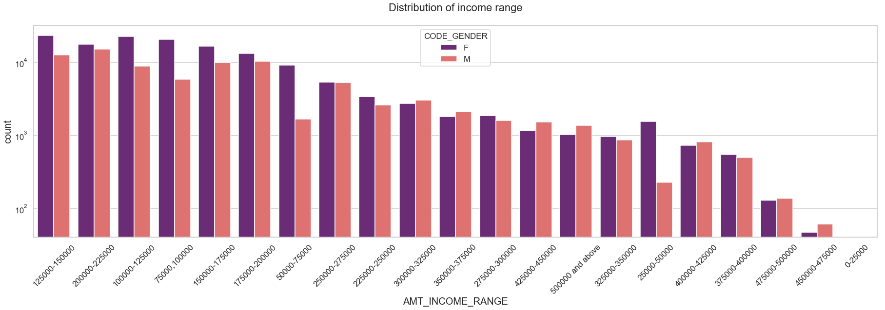
Distribution of Income range
Points to be concluded from the graph on the right side.
Female counts are higher than male.
Income range from 100000 to 200000 is having more number of credits.
This graph show that females are more than male in having credits for that range.
Very less count for income range 400000 and above.

Slide 4
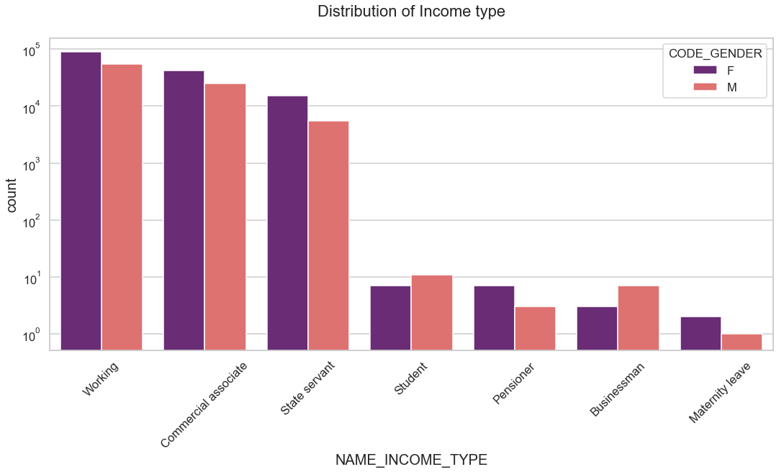
Distribution of income type
Points to be concluded from the graph on the right.
For income type ‘working’, ’commercial associate’, and ‘State Servant’ the number of credits are higher than others.
For this Females are having more number of credits than male.
Less number of credits for income type ‘student’ ,’pensioner’, ‘Businessman’ and ‘Maternity leave’.

Slide 5
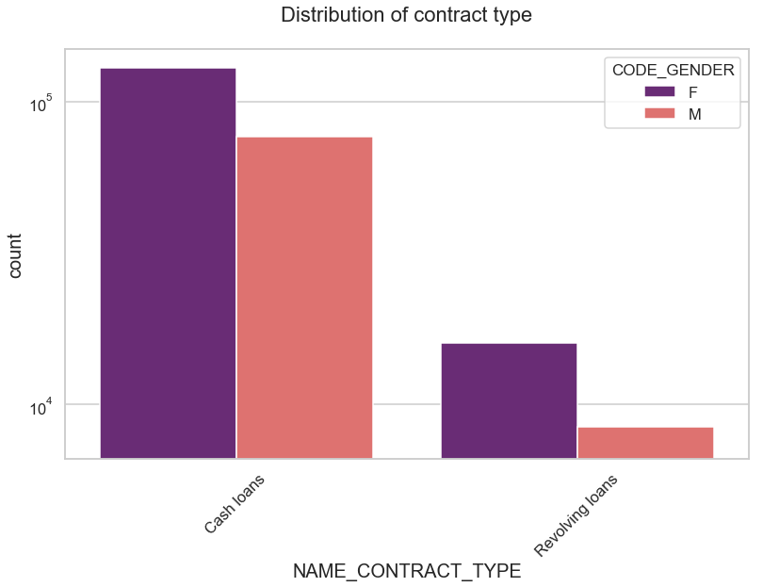
Distribution for contract type
Points to be concluded from the graph on the right.
For contract type ‘cash loans’ is having higher number of credits than ‘Revolving loans’ contract type.
For this also Female is leading for applying credits.

Slide 6
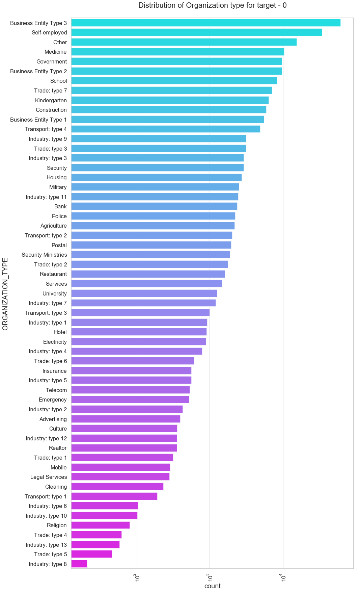
Distribution of organization type
Points to be concluded from the graph on the right.
Clients which have applied for credits are from most of the organization type ‘Business entity Type 3’ , ‘Self employed’ , ‘Other’ , ‘Medicine’ and ‘Government’.
Less clients are from Industry type 8,type 6, type 10, religion and trade type 5, type 4.

Slide 7
Categorical Univariate analysis for target 1

Slide 8
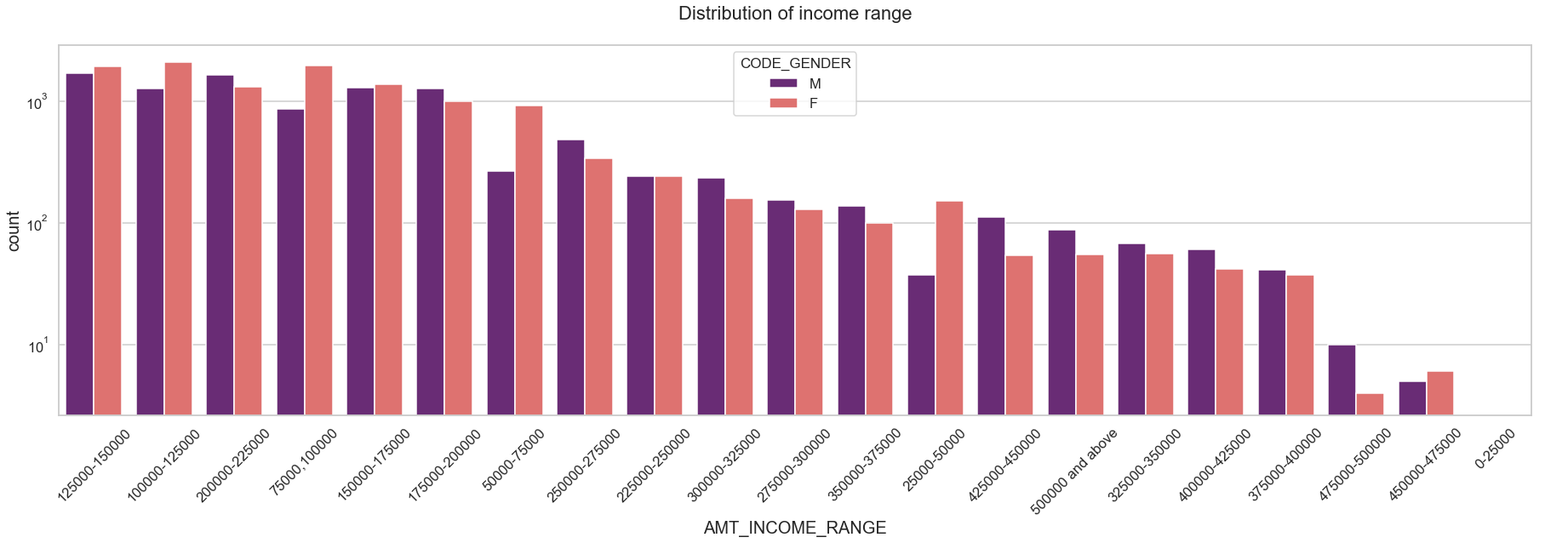
Distribution of Income range
Points to be concluded from the graph on the right side.
Male counts are higher than female.
Income range from 100000 to 200000 is having more number of credits.
This graph show that males are more than female in having credits for that range.
Very less count for income range 400000 and above.

Slide 9
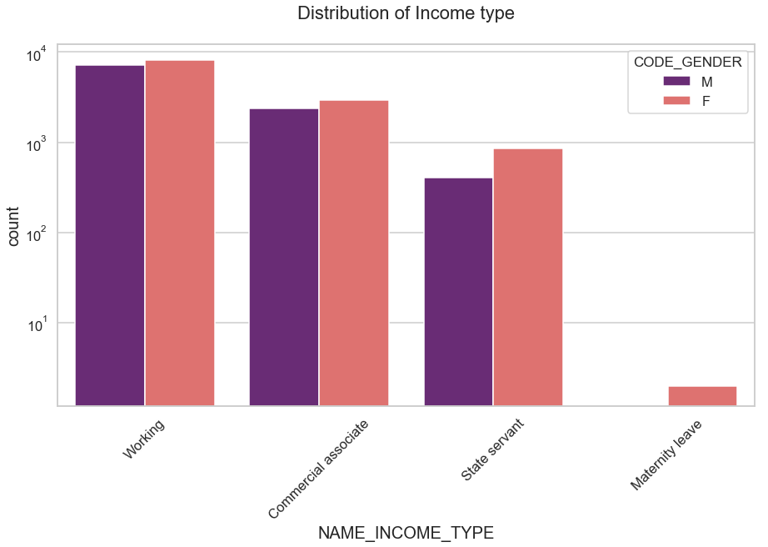
Distribution of income type
Points to be concluded from the graph on the right side.
For income type ‘working’, ’commercial associate’, and ‘State Servant’ the number of credits are higher than other i.e. ‘Maternity leave.
For this Females are having more number of credits than male.
Less number of credits for income type ‘Maternity leave’.
For type 1: There is no income type for ‘student’ , ’pensioner’ and ‘Businessman’ which means they don’t do any late payments.

Slide 10
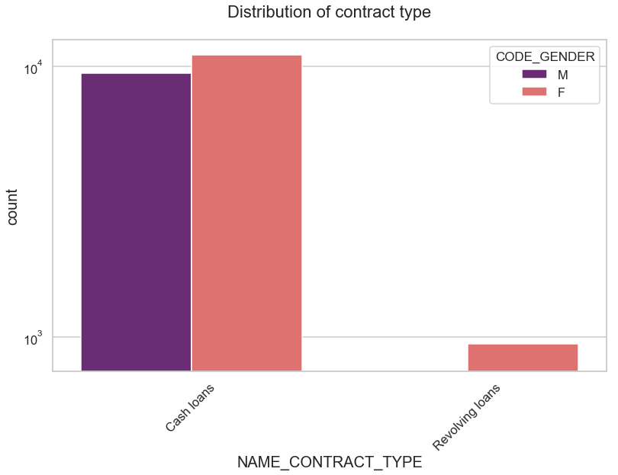
Distribution for contract type
Points to be concluded from the graph on the right.
For contract type ‘cash loans’ is having higher number of credits than ‘Revolving loans’ contract type.
For this also Female is leading for applying credits.
For type 1 : there is only Female Revolving loans.

Slide 11

Distribution of organization type
Points to be concluded from the graph on the right.
Clients which have applied for credits are from most of the organization type ‘Business entity Type 3’ , ‘Self employed’ , ‘Other’ , ‘Medicine’ and ‘Government’.
Less clients are from Industry type 8,type 6, type 10, religion and trade type 5, type 4.
Same as type 0 in distribution of organization type.

Slide 12
Correlation of target 0

Slide 13
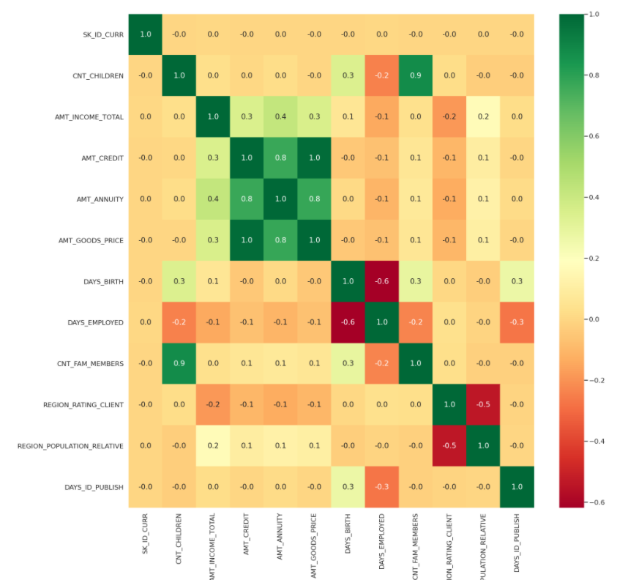

Slide 14
Correlation For target 0
Points to be concluded from the graph presented before.
Credit amount is inversely proportional to the date of birth, which means Credit amount is higher for low age and vice-versa.
Credit amount is inversely proportional to the number of children client have, means Credit amount is higher for less children count client have and vice-versa.
Income amount is inversely proportional to the number of children client have, means more income for less children client have and vice-versa.
less children client have in densely populated area.
Credit amount is higher to densely populated area.
The income is also higher in densely populated area.

Slide 15
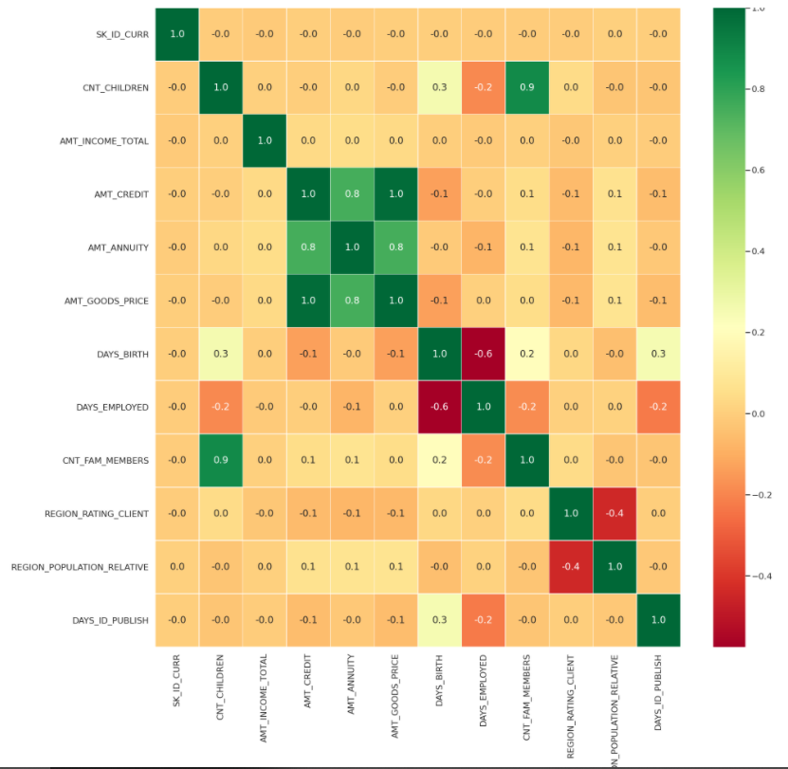

Slide 16
Correlation for type 1
This heat map for Target 1 is also having quite a same observation just like Target 0. But for few points are different. They are listed below.
The client's permanent address does not match contact address are having less children and vice-versa
The client's permanent address does not match work address are having less children and vice-versa

Slide 17
Univariate analysis for variables target 0

Slide 18

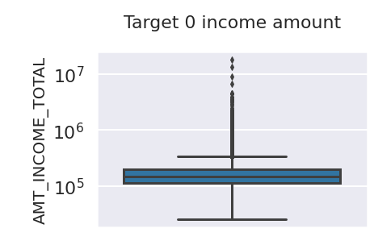
Boxplot for income amount
Few points can be concluded from the graph.
Some outliers are noticed in income amount.
The third quartiles is very slim for income amount.

Slide 19
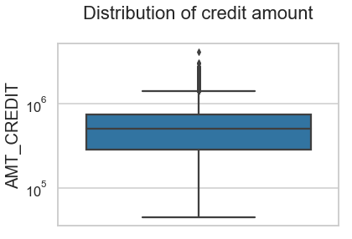
Boxplot for credit amount
Few points can be concluded from the graph.
Some outliers are noticed in credit amount.
The first quartile is bigger than third quartile for credit amount which means most of the credits of clients are present in the first quartile.

Slide 20
Univariate analysis for variables target 1

Slide 21
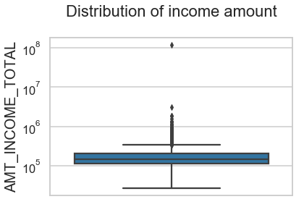
Boxplot for income amount
Few points can be concluded from the graph.
Some outliers are noticed in income amount.
The third quartiles is very slim for income amount.
Most of the clients of income are present in first quartile.

Slide 22
Boxplot for credit amount
Few points can be concluded from the graph.
Some outliers are noticed in credit amount.
The first quartile is bigger than third quartile for credit amount which means most of the credits of clients are present in the first quartile.

Slide 23
Bivariate analysis for type 0

Slide 24
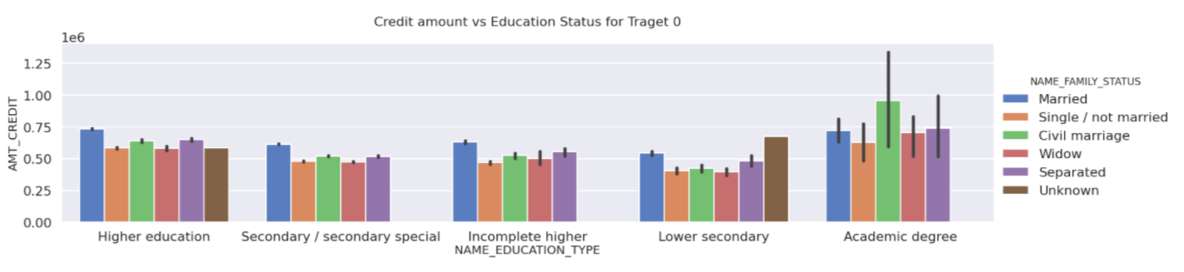
Credit amount vs Education Status
Few points can be concluded from the graph.
Family status of 'civil marriage', 'marriage' and 'separated' of Academic degree education are having higher number of credits than others.
Higher education of family status of 'marriage', 'single' and 'civil marriage' are having more outliers.
Civil marriage for Academic degree is having most of the credits in the third quartile.

Slide 25
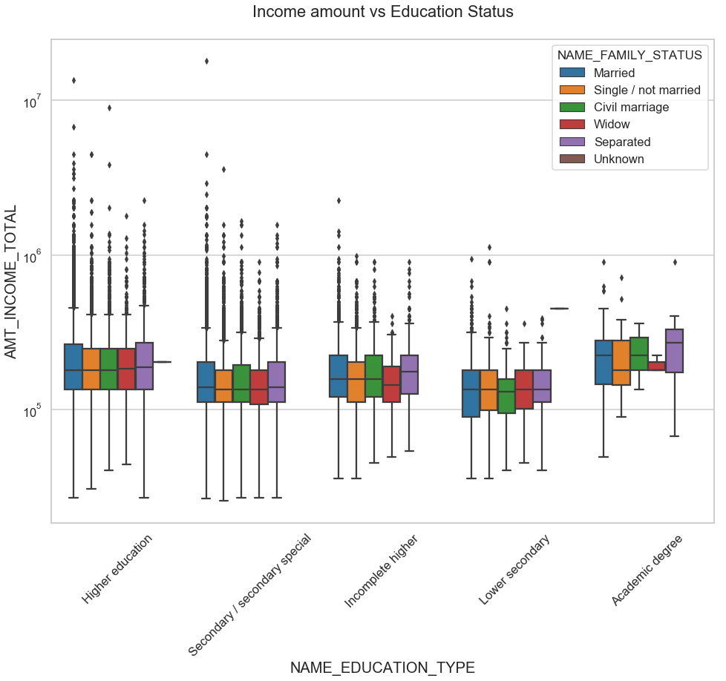
Income amount vs Education Status
Few points can be concluded from the graph.
For Education type 'Higher education' the income amount mean is mostly equal with family status. It does contain many outliers.
Less outlier are having for Academic degree but they are having the income amount is little higher that Higher education.
Lower secondary of civil marriage family status are have less income amount than others.

Slide 26
Bivariate analysis for type 1

Slide 27
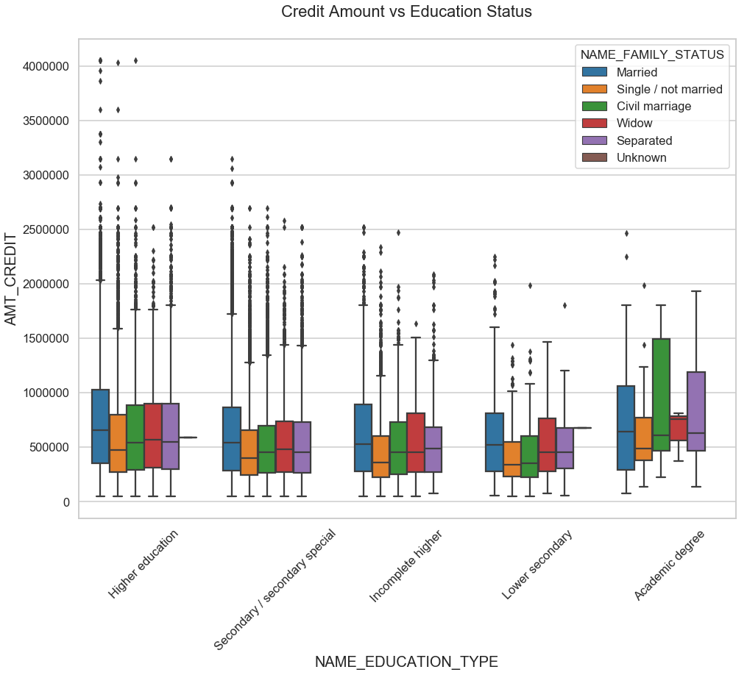
Credit amount vs Education Status
Few points can be concluded from the graph.
Quite similar from Target 0, we can say that Family status of 'civil marriage', 'marriage' and 'separated' of Academic degree education are having higher number of credits than others.
Most of the outliers are from Education type 'Higher education' and 'Secondary’.
Civil marriage for Academic degree is having most of the credits in the third quartile.

Slide 28
Income amount vs Education Status
Few points can be concluded from the graph.
Have some similarity with Target0, From above boxplot for Education type 'Higher education' the income amount is mostly equal with family status.
Less outlier are having for Academic degree but there income amount is little higher that Higher education.
Lower secondary are have less income amount than others.

Slide 29
analysis after merging previous data

Slide 30
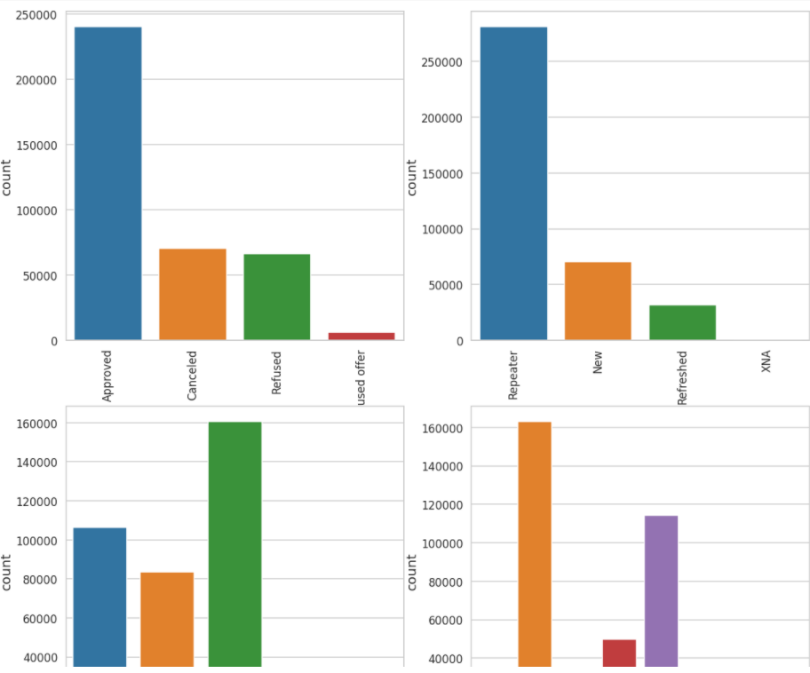
Approved loans are more in numbers. Repeater clients applied for more number of loans previously. Previously more loans credited as POS. Through country-wise channel more loans were processed followed by credit and cash offers.

Slide 31
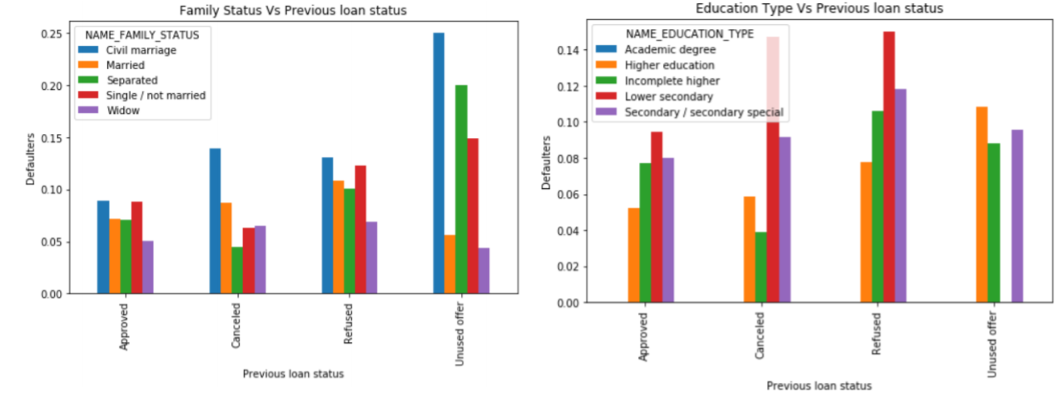
• Clients with civil marriage are highest defaulters in every previous loan status. • Separated and Single people who did not used previous loans are significant in terms of defaulters in current application. • Married and widow clients are safe to credit loan. • Lower secondary educated clients are the most in number to be defaulted when their previous loans were cancelled or refused. • Client who has higher education are safe to credit loan when their previous application was approved.

Slide 32
Recommended group where loan can be credited. (Less chance to be defaulter)
• Clients who are working as a state servant.
• Old people of any income group.
• Client with high income category.
• Old female client.
• Client with higher education (female).
• Any client who’s previous loan was approved.
• Widow who has unused previous loan status.
• Refreshed client who has unused loan status previously.

Slide 33
Risky group
• Lower secondary educated clients are the most in number to be defaulted when their previous loans were cancelled or refused.
• Male clients with civil marriage.
• Previously refused loan status group.

Slide 34
Thank you

